Slide 1
Analysis of Medical Cost Personal Datasets
Is362 Final Project Presentation

Slide 2
Why medical cost analysis matters?
Medical cost analysis helps identify ways to save on Health Insurance Cost. It demonstrates not only the utility of allocating resources from ineffective to effective interventions, but also the utility of allocating resources from less to more cost-effective interventions.
Insurance cost directly affects the degree to which individuals are inhibited or facilitated in their ability to gain entry to and to receive care and services from the health care system. Factors influencing higher insurance premiums include age, Body Mass Index (BMI), habits such as smoking, children status and region.

Slide 3
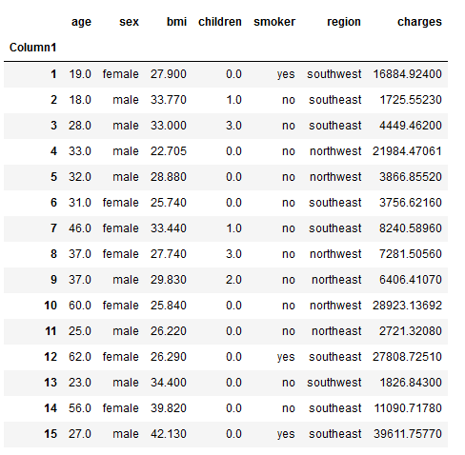
Medical Cost Sample

Slide 4
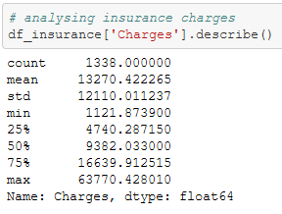
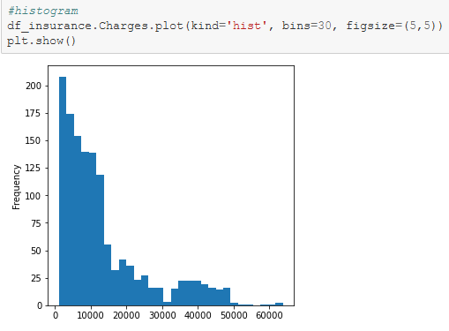
Analyze Data and Graph

Slide 5
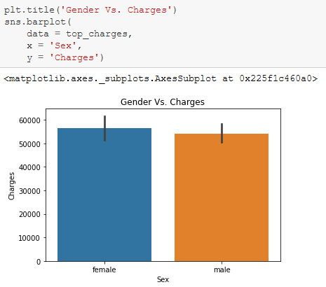
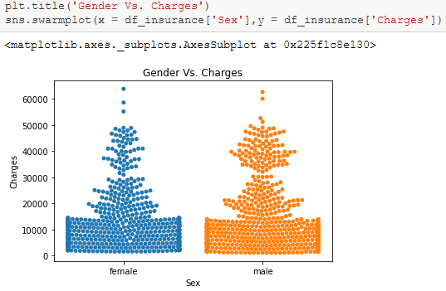
What is the difference in cost between Males and Females?
We can conclude that gender does not increase insurance charges. Bar chart shows females pay slightly more than males, but if we analyze data from swarm plot, that difference is low.

Slide 6
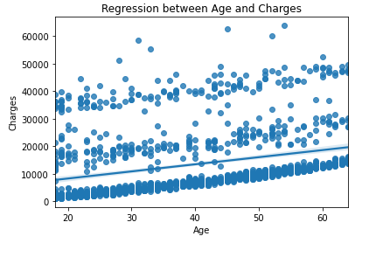
What is correlation between Age and Charges?
We can conclude that age increases insurance cost.

Slide 7
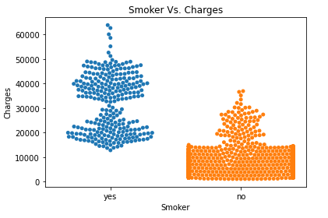
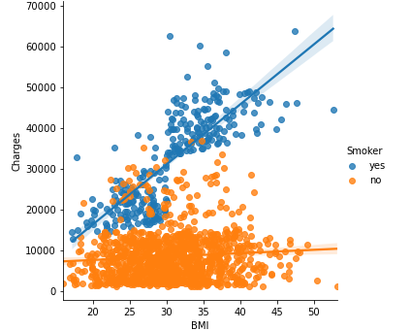

Does smoking increases insurance charges?
We can conclude that smokers pay higher insurance premiums than nonsmokers.

Slide 8
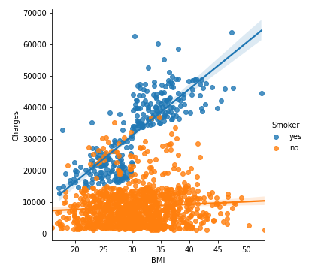
Does BMI increases insurance cost for smokers?
Based on regression lines we can conclude that for both smokers and nonsmokers higher BMI means higher insurance cost. However, smokers pay higher insurance charges than nonsmokers.

Slide 9

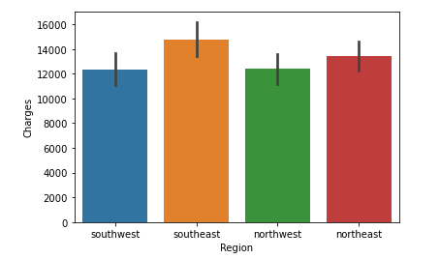
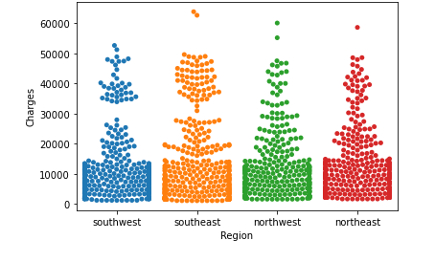
Does region increase insurance costs?
According to both graphs, cost of insurance from The East region is higher than The west.

Slide 10
Conclusion Analysis of Medical Cost Personal Datasets confirmed that insurance cost increase based on :
AGE
BMI
SMOKING
CHILDREN
REGION

